Slide 1
Occupational Health and Safety
EC/Env-309
(3 = 2+1)
BS SEMESTER 6
SESSION 2017-21
Course Tutor: Ms. Hina Chaudhry

Slide 2


Slide 3
Aim:
To study about different methods used for controlling occupational hazards.
Outcomes:
The students will be able to:
Understand different methods used for controlling occupational hazards
Differentiate between these methods
Apply these methods in different workplaces

Slide 4
Topic of course outline:
Methods of Control of Occupational Hazards:
Elimination
Substitution
Engineering controls
Administrative Controls
Personal Protective Equipment PPE

Slide 5
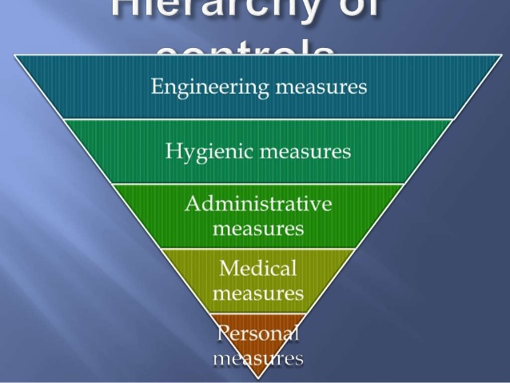

Slide 6
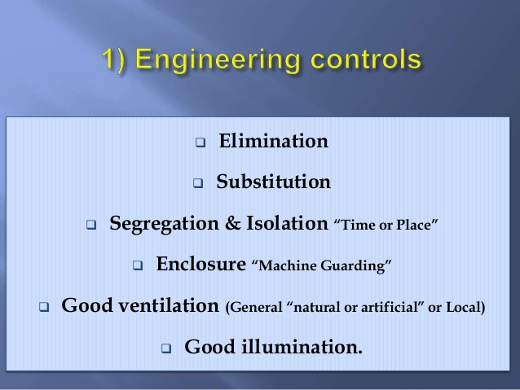

Slide 7
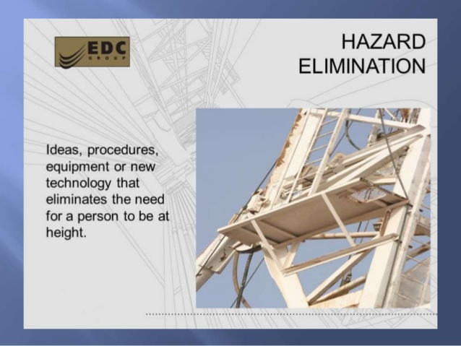

Slide 8
Substitution
Sometimes it is possible to substitute less hazardous materials, equipment or even processes for more hazardous ones.
Examples:
solvents such as dichloromethane has been substituted for carbon tetrachloride.
Toluene has been substituted for benzene
Use of safety glass as opposed to regular glass
Substitution of a wet method of operation for a dry method, where dust becomes a serious hazard.

Slide 9
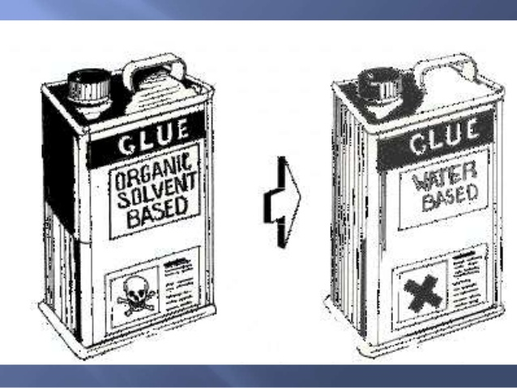

Slide 10
Isolation
It is the physical separation of the worker from the hazard by use of a barrier, by increasing the distance from, or decreasing the time of exposure to, the hazardous material.
Examples:
Radioactive materials may be stored in concrete vaults
The work is performed by remote control
Enclosures are another method of isolation

Slide 11


Slide 12
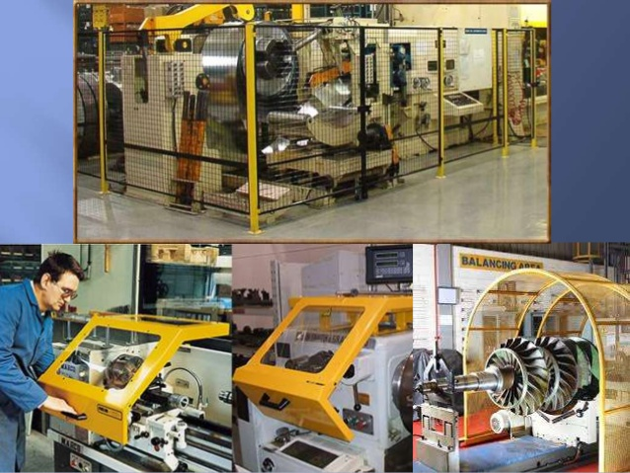

Slide 13
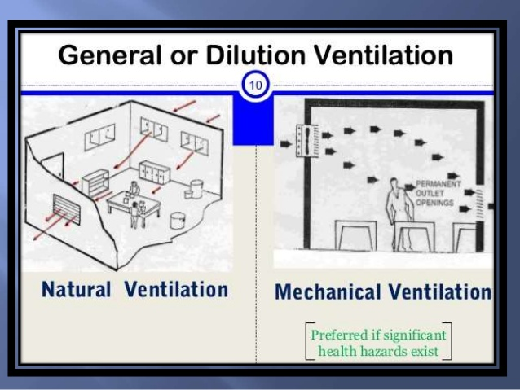

Slide 14
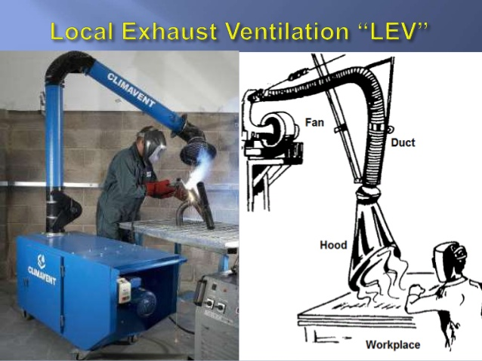

Slide 15


Slide 16
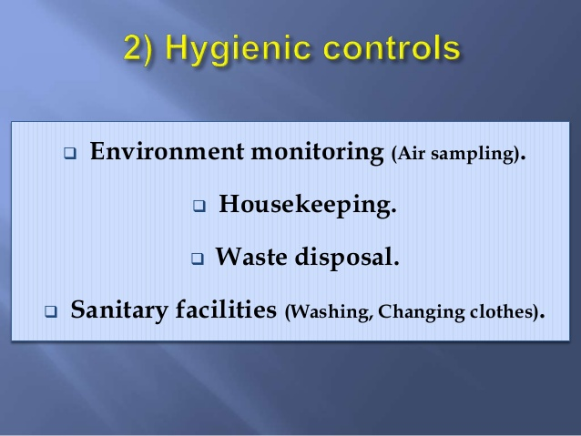

Slide 17
